Slide 1

State-wise Data of First Census of Water Bodies - Tamil Nadu
DATA ANALYSIS ON GOVERNMENT DATA SET
J. Sravani

Slide 2
Content:
About the WBC_TN.csv Dataset
Steps in the Process of Research
Analyzing and Interpreting Data
Steps Involved in Data Analysis
Problems in the WBC_TN Dataset
Data Visualization

Slide 3
DATA ANALYSIS REPORT:
1. About the WBC_TN.csv Dataset:
The WBC_TN.csv dataset contains information related to water bodies in Tamil Nadu, India. It includes 106,957 entries across 35 columns, covering various attributes such as:
Water body details: Names, basin and sub-basin information
Geographical data: Location, state name, district, taluk
Usage and beneficiaries: Number of towns, villages, and people benefiting from the water body
Storage and capacity metrics: Original and current storage capacities
Renovation details: Year of renovation and associated projects
Administrative aspects: Department managing the water body, reference selection ID
This dataset is crucial for analyzing water resource management, identifying trends in renovation projects, and assessing the impact of water bodies on local populations.

Slide 4
2. Steps in the Process of Research:
Research follows a structured approach that includes:
Identifying the research problem: Understanding the key issues related to water resource management in Tamil Nadu, such as water availability, storage capacity, and renovation impact.
Conducting a literature review: Reviewing past studies on water body management, government reports, and previous research on water conservation strategies.
Defining objectives and hypotheses: Establishing research goals such as identifying trends in renovation, assessing population impact, and analyzing storage capacity variations over time.
Selecting research methods and tools: Choosing statistical methods, visualization techniques, and machine learning models to analyze the dataset.
Collecting data: Using the WBC_TN.csv dataset as the primary data source, supplemented with external water resource reports if necessary.
Analyzing and interpreting data: Cleaning the dataset, handling missing values, performing exploratory data analysis (EDA), and applying statistical techniques to identify insights.

Slide 5
3. Analyzing and Interpreting Data:
Analyzing data involves processing and summarizing collected information to find patterns and relationships. Interpretation follows analysis and seeks to explain trends, correlations, and anomalies within the dataset. This step often involves statistical techniques to validate findings.
Analysis of the WBC_TN.csv Dataset:
Exploratory Data Analysis (EDA): Conducted descriptive statistics and visualized data using histograms, box plots, and scatter plots.
Missing Value Treatment: Identified and handled missing values in key columns like basin_name, sub_basin_name, renovation_year, and no_people_benefited_by_water_body.
Data Cleaning and Standardization: Formatted state names, corrected categorical inconsistencies, and converted numerical fields to appropriate data types.
Duplicate Check: Verified and removed any redundant records using the unique_id field.
Outlier Detection: Used box plots and statistical methods to identify anomalies in storage capacities and population benefited.

Slide 6
Visualization: Created a different plots, including:
Distribution of water bodies across districts
Trends in renovation over time
Correlation between storage capacity and the number of beneficiaries
Heatmaps for missing data representation
Pie charts for categorical distributions
Bar graphs for frequency analysis of water body types
4. Steps Involved in Data Analysis:
Data Collection: Gathering raw data from reliable sources.
Data Cleaning: Removing inconsistencies, handling missing values, and standardizing data formats.
Exploratory Data Analysis (EDA): Summarizing main characteristics, visualizing trends, and detecting anomalies.
Statistical Analysis: Applying statistical methods to test hypotheses.
Data Interpretation: Drawing meaningful conclusions based on the analyzed data.
Reporting and Visualization: Presenting findings through graphs, tables, and reports.

Slide 7
5. Problems in the WBC_TN Dataset:
The dataset WBC_TN.csv contains several data quality issues that need to be addressed.
Missing Values:
Several columns have missing data, such as:
basin_name (~31% filled)
sub_basin_name (~30% filled)
water_body_name (~88% filled)
renovation_year (~49% filled)
no_town_cities_benefited, no_villages_benefited, no_people_benefited_by_water_body (~40-50% missing)
Inconsistent Data Types:
Some numerical values (e.g., renovation_year, storage_capacity_water_body_original) are stored as float64 instead of integers.

Slide 8
Some categorical fields (e.g., ref_selection_id_wua_exists_name) contain values like "Not Known" instead of standard categories.
Potential Duplicates:
The dataset contains a unique_id column, but duplicate records need to be checked.
Data Standardization Needed:
State Name is in uppercase (e.g., "TAMIL NADU") and may need formatting.
water_body_name and other categorical fields have inconsistent naming conventions.
Next Steps:
I will:
Clean the dataset (handle missing values, check duplicates, and standardize columns).
Generate 20 different plots to visualize the dataset.
Identify anomalies in the data (such as outliers and inconsistencies).

Slide 9
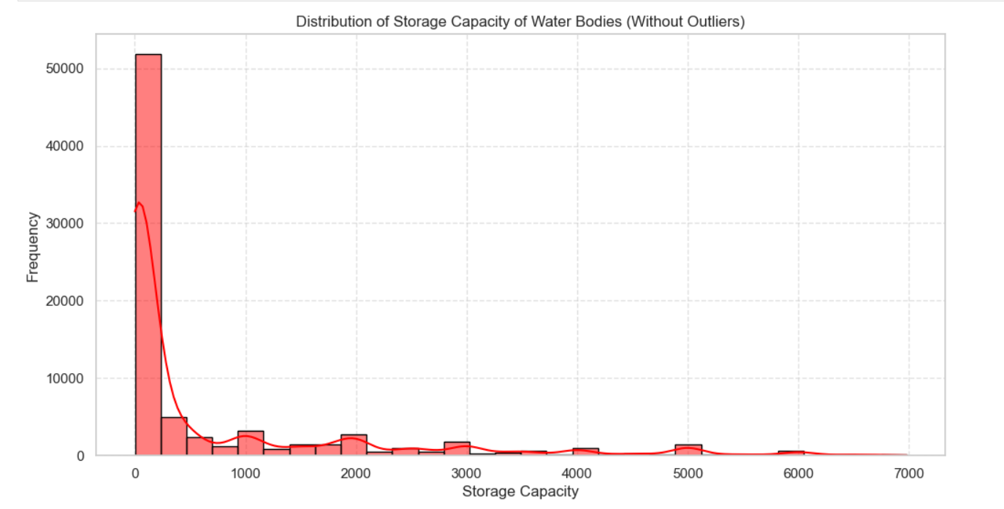
6. Data Visualization:
Data visualization is a crucial aspect of data analysis as it helps in understanding trends, patterns, and anomalies effectively. The following visualization techniques were applied to the WBC_TN.csv dataset:
Histograms: Showed the distribution of numerical attributes such as storage capacity, helping us understand data spread and skewness.

Slide 10
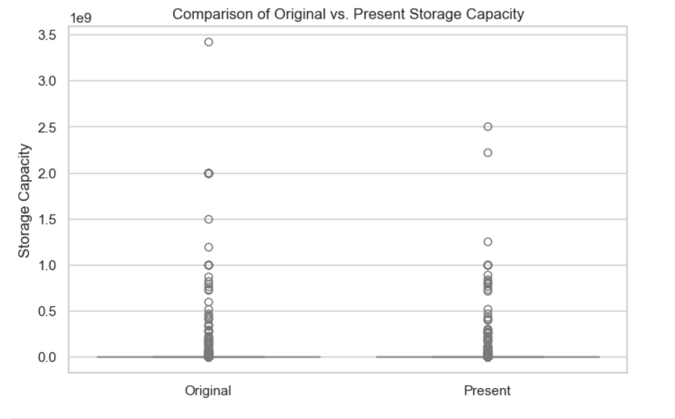
Box Plots: Identified outliers in renovation years and storage capacities, allowing us to detect anomalies in the dataset.

Slide 11
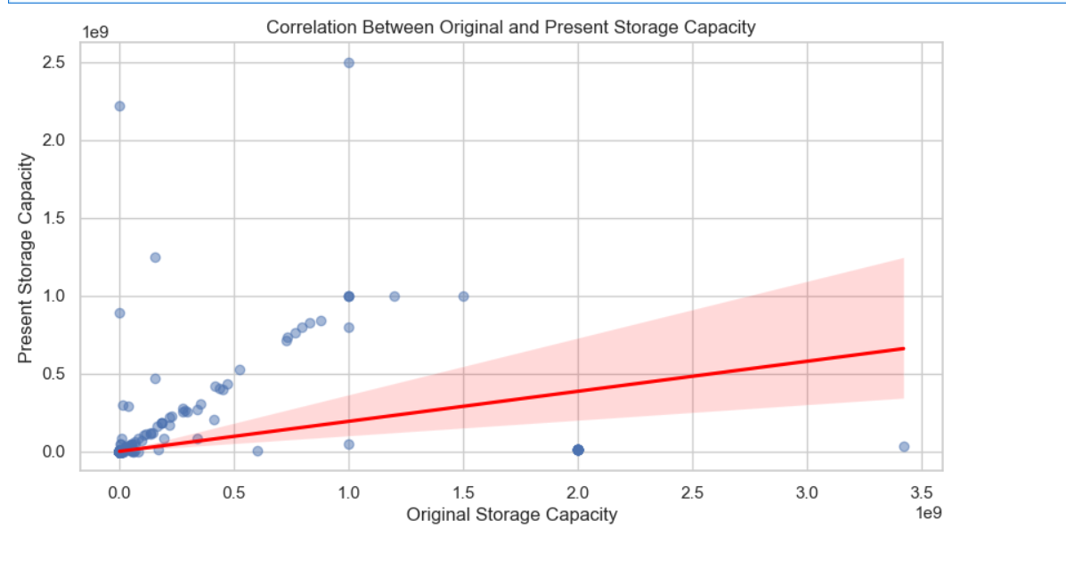
Scatter Plots: Explored relationships between water body capacity and the number of beneficiaries, providing insights into how storage impacts the population.

Slide 12
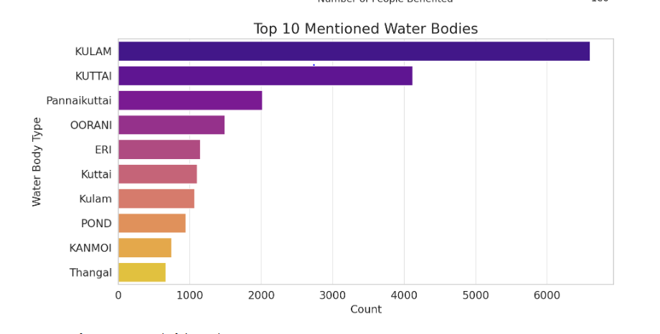
Bar Charts: Displayed frequency counts of categorical variables like basin name and district, helping in analyzing geographical distribution.

Slide 13
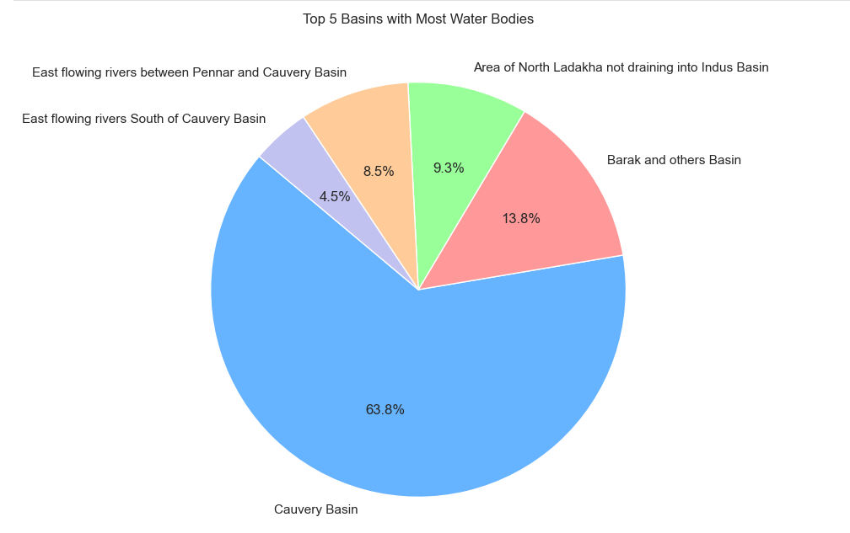
Pie Charts: Represented proportions of different types of water bodies, illustrating the distribution of categories visually.

Slide 14
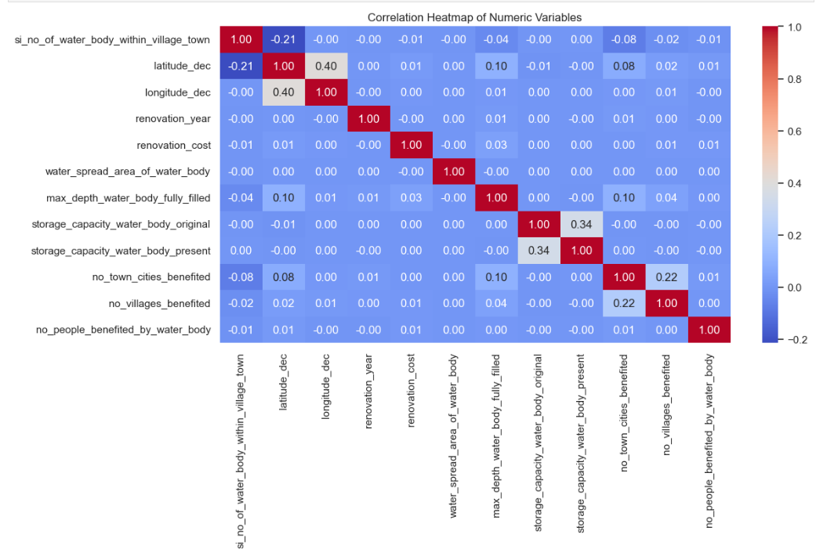
Heatmaps: Showed correlations between numerical features, revealing relationships and dependencies within the dataset.

Slide 15
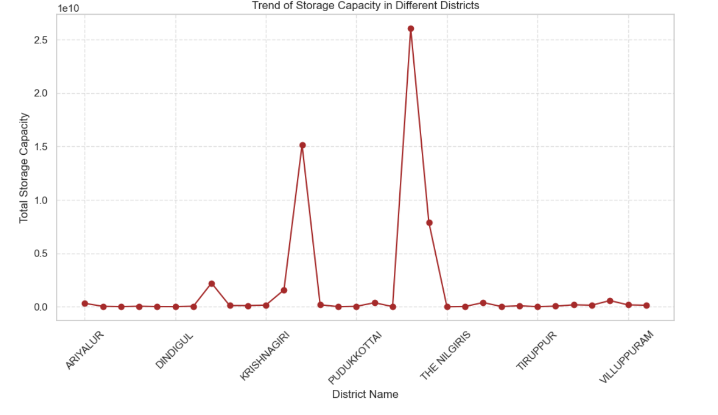
Line Graphs: Illustrated trends in renovation over time, enabling us to track changes in water body improvements.
7. Conclusion
Data analysis is an essential part of research and decision-making, enabling organizations and researchers to derive actionable insights. By following a structured approach and utilizing appropriate statistical and analytical techniques, one can effectively interpret data and make informed decisions.

Slide 16


